Slide 1
Comparative Analysis of Customer Sentiments on Competing Brands using Hybrid Model Approach
Srivats Athindran.N
Manikandaraj.S
Kamaleshwar.R

Slide 2
Objective
The approach of sentiment analysis is utilized to derive individual user perceptions about the different features of the new releases of two leading Smartphone brands in India- Vivo and Oppo.
From the user comments and reviews on Twitter for the smartphones Vivo Nex and Oppo FindX, sentiments are classified and using the sentiment classification the different features such as Camera, display etc are compared to determine which brand has better acceptance among customers.

Slide 3
Approach
The tweets pertaining to the two smartphones Vivo Nex and Oppo FindX are used as individual customer feedback and the sentiment for each tweet is classified using a hybrid model which is a combination of the Lexicon Based Sentiment analysis and the Naive Bayes algorithms.
Then, for feature wise comparison, the tweets based on individual features are taken out and compared using their sentiment classifications.
Word-clouds are built for the overall tweets as well as for individual features for both the smart phones.

Slide 4
Data Preprocessing
Tweets were taken into a Corpus.
Languages other than English, punctuations, specific unrelated hash tags, re-tweets, URLs were removed. Tweets put up by users who had less than 10 followers were also removed to eliminate the less impactful tweets.
The pre-processing stage also involved breaking the string of sentences in tweets into tokens and stemming the words in each of the tweets.

Slide 5
Hybrid model based sentiment analysis approach
Once the pre-processing stage for the extracted tweets is complete and the words are stemmed, the filtered data is taken as the input for the Hybrid model.
The Hybrid model uses the Lexicon Based approach to classify the sentiments initially.
Then, Supervised Machine learning process is followed. The classified tweets are segregated into train and test dataset. The model is built on the train dataset and it is validated on both the train and test dataset

Slide 6
Lexicon Based Sentiment Classification
This technique is also called as Dictionary based classification technique.
In our Lexicon model, the sentiments scores are obtained through a function called analyse sentiment and by means of using the dictionary called Harvard-IV.
The sentiment scores obtained are converted to directions i.e. positive, negative and neutral. The resultant classifications are joined as a column with the cleaned dataset.

Slide 7
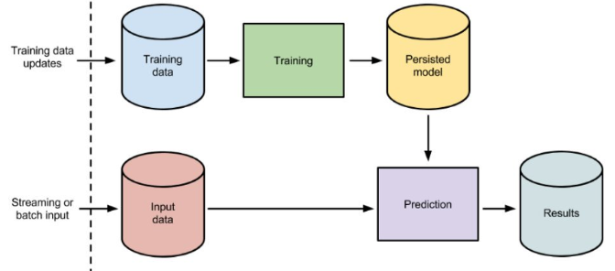
Supervised Learning based Sentiment Classification
The dataset which has the results of the lexicon based classifier is taken for the Supervised Machine learning approach and subsequently classified using the Naive Bayes Classification algorithm
Here the overall dataset is partitioned into training dataset and test dataset

Slide 8
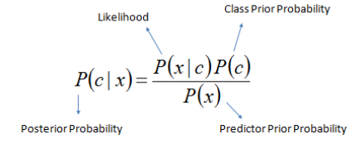
Naïve Bayes Sentiment Classifier
The Naïve Bayes Classifier makes use of the Bayes theorem for classifying sentiments of each tweet, which works on the assumption that all variables/features that are taken for prediction are independent

Slide 9
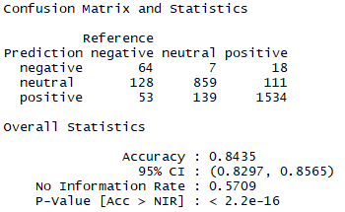
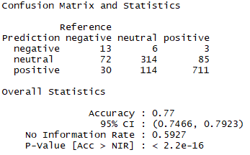
Naïve Bayes Sentiment Classifier (Contd)
The training dataset is trained by passing it through the Naïve Bayes Classifier, which applies the Bayes theorem and classifies the sentiments.
Using the trained model, the outcome of the test dataset is predicted by means of a predict function.
Hybrid Model Performance Statistics on Training Dataset
Hybrid Model Performance Statistics on Test Dataset

Slide 10


Comparison of overall sentiments
The individual sentiment classifications for each of the smartphone brands is now taken and compared to obtain an overall feedback from the twitter users.
Sentiment classification for Nex tweets
Sentiment classification for FindX tweets
The percentage of positive tweets for Vivo Nex is 69% as compared to the percentage of positive tweets of 54% for Oppo Find X. Also, the percentage of negative tweets is 6.5% for Oppo FindX, which is higher than the percentage of negative tweets for Vivo Nex, which is only 2%. This clearly illustrates the fact the Vivo Nex has an overall positive Feedback from the users when compared to Oppo FindX.

Slide 11
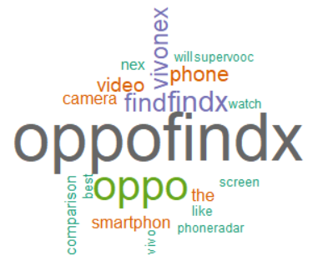
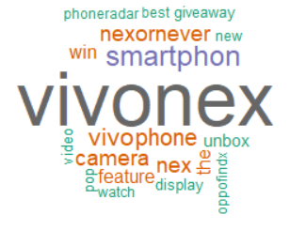
Overall comparison word-cloud
Word-cloud for tweets about Vivo Nex
Word-cloud for tweets about Oppo FindX
So, we see using the overall word clouds that the most talked features about both the smartphones are display and camera. These two smartphones have introduced new concepts called complete bezel less display and pop up camera. To provide an in-depth comparison for the two smartphones, a feature-based comparison is done.

Slide 12



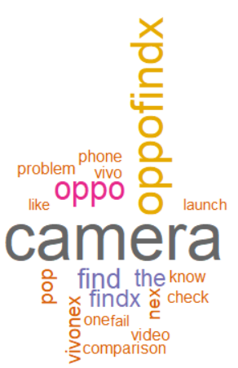
Camera comparison
Sentiment classification for tweets about camera of Nex
Sentiment classification for tweets about camera of FindX
Word-cloud for tweets about camera of Nex
Word-cloud for tweets about camera of FindX
Upon comparison, the camera feature of the Vivo Nex smartphone yields more positive feedback (90% positive) from the audience over Oppo FindX (69% positive). In tweets of both the phones, they seem to talk a lot about the pop-up camera.

Slide 13


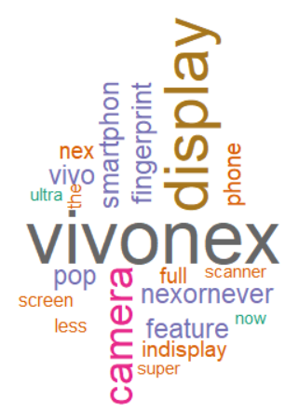
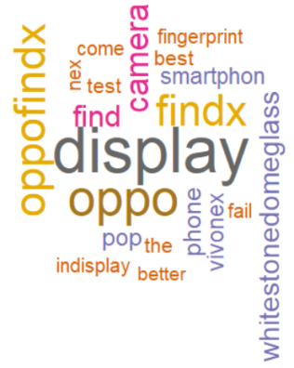
Display comparison
Sentiment classification for tweets about display of Nex
Sentiment classification for tweets about display of FindX
Word-cloud for tweets about display of Nex
Word-cloud for tweets about display of FindX
The display feature of the Vivo Nex smartphone yields more positive feedback (91% positive) from the audience over Oppo FindX (73% positive).

Slide 14
New features introduced
Both the brands have introduced two new features, Bezel-less display and Pop-up camera.
We saw using the word clouds that these were the most talked topics. The next most talked feature was the on-screen fingerprint sensor.
In order to check the sentiment among customers for these new features, we compared the sentiments of the tweets pertaining to these features.

Slide 15



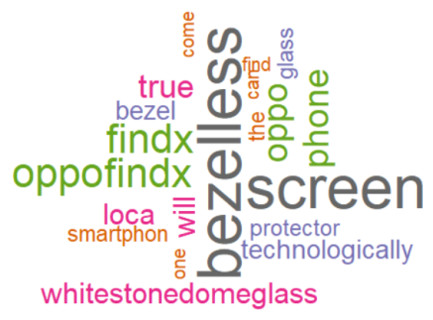
Bezel-less display feature comparison
Sentiment classification for tweets about Nex’s bezel less feature
Sentiment classification for tweets about FindX’s bezel less feature
Word-cloud for tweets about bezel less feature of Nex
Word-cloud for tweets about bezel less feature of FindX
On comparing the percentage of positive tweets, the bezel less feature of the Vivo Nex smartphone has a slight edge over the bezel less feature of Oppo FindX. The bezel less feature in both the smartphones seems to be the most appreciated feature by the customers as indicated by zero negative reviews.

Slide 16



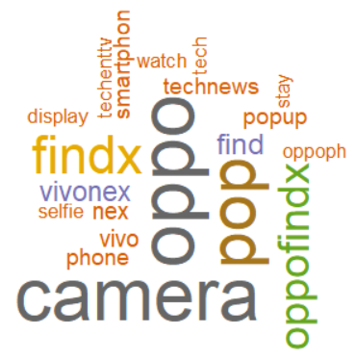
Pop-up Camera comparison
Sentiment classification for tweets about Nex’s pop up feature
Sentiment classification for tweets about FindX’s pop up feature
Word-cloud for tweets about pop up camera feature of Nex
Word-cloud for tweets about pop up camera feature of FindX
Comparing the two, the pop-up camera feature of the Vivo Nex smartphone yields slightly more positive feedback from the audience over Oppo FindX.

Slide 17
Results
So, when we did an overall comparison of the sentiments of Vivo Nex and Oppo FindX, Vivo Nex had a clear lead in terms of overall positive sentiment.
We then deep dived to see the feature wise sentiment in terms of the two new features in both the smartphones, the Bezel-less display and pop-up camera. In both these areas, Vivo Nex has a slight edge over the Oppo FindX in terms of positive sentiments.
One more feature which was being discussed in the tweets in addition to the camera and display is the on-screen fingerprint sensor.

Slide 18
Conclusion
We have done an effective comparison of two new products from two competing brands.
This paper has typically shown how social media data can be used to measure the user sentiments about products that are newly launched.
This approach can then be effectively used by brands to see where they outweigh their rivals.
They can also get to know the areas where they come lesser than their rivals. They can then work on improving in those areas

